Slide 1


Design and Development of a Web Application
in a Containerized Environment
Supervisor:
Prof. Pierpaolo Baglietto
Cosupervisor:
Dott. Marco Risso
Candidate:
Fabrizio Durante
Student ID n. 3941665

Slide 2
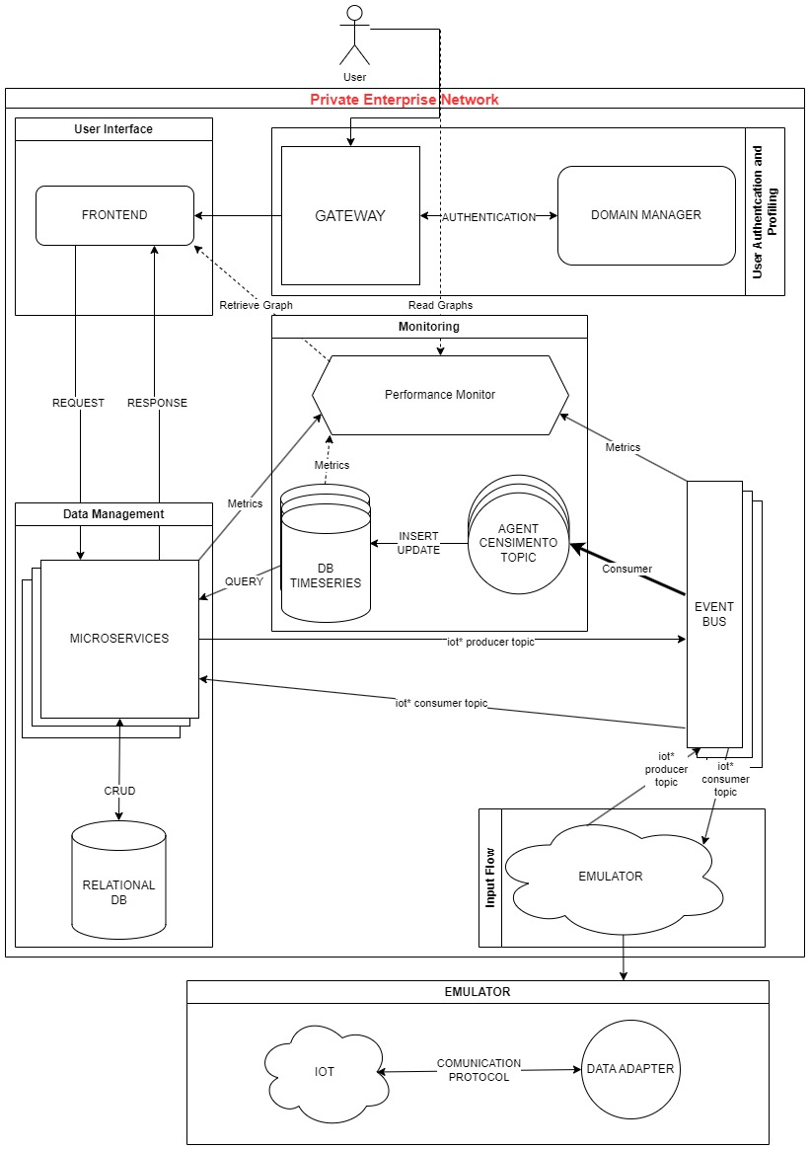
architecture
Groups
Input Flow
Data Management
User Interface
Authentication
Monitoring

Slide 3
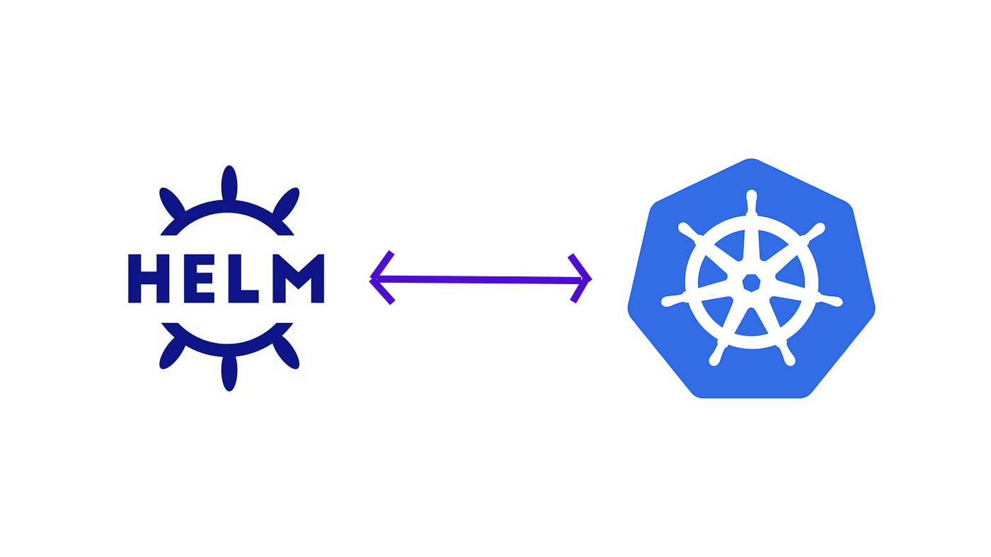
Core technologies
Kubernetes
Container Orchestration Platform
Pod
Controller
Helm
Package Manager for Kubernetes
Charts
Release

Slide 4



Event Streaming Bus
Apache Kafka
ZooKeeper
Message Broker
Topics
Producers
Consumers / Consumer Groups
Distributed Coordination
Quorum
ZNode

Slide 5
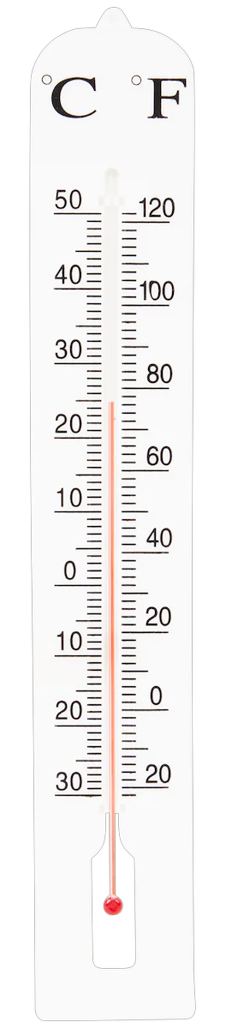


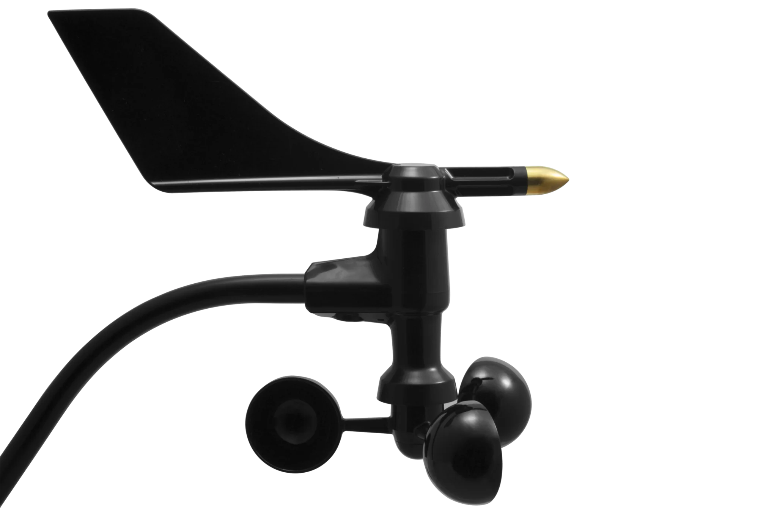


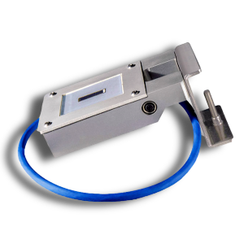
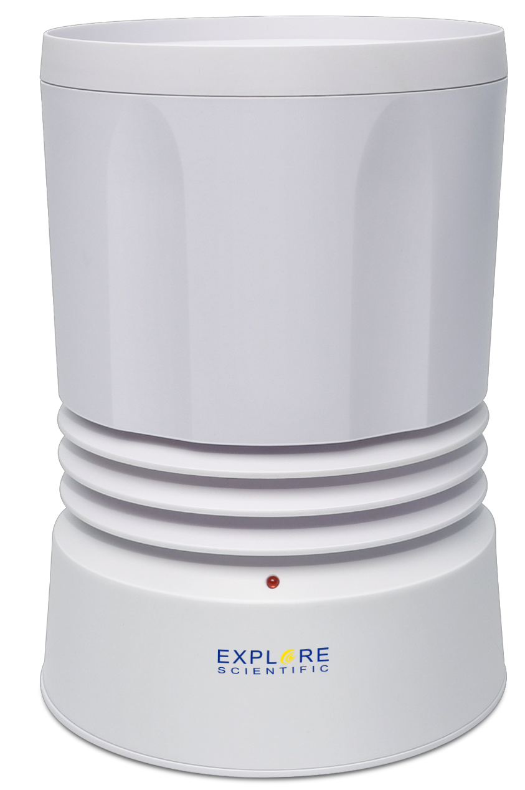

Input Flow
Adapters
Python
Interpreted Programming Language
Dynamic Typing
Easy Kafka Integration
Quite good low-level communication
AdaptersManager

Slide 6
Input Flow
Adapters
Adapters
Comunicate with the phisical device
Getting data
Distribute data through Kafka
High performaces
Manager
Check the Adapters Health Status
Send alert to the UI
AdaptersManager

Slide 7


Data Management
Spring Boot
User Interface
Microservices
User Interface
User Interface
Convention over Configuration
SOCKET SERVICE
Auto-Configuration
Embedded Web Server
CONFIGURATION SCHEDULER
Rest Service
REST SERVICE
REST Web Server
Hibernate
Socket Service
Socket Web Server
INPUT FLOW
Kafka producer/consumer
Configuration Scheduler
Kafka producer
Hibernate

Slide 8





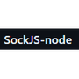
USER interface
AUTHENTICATION
UI
React
Component
Virtual DOM
State and Props
Responsive
UI
DATA MANAGEMENT
Device registry
Devices configuration

Slide 9






monitoring
INPUT FLOW
Monitoring System
Hosting machine resources consumption metrics
Pods resources consumption metrics
Kafka resources usage metrics
Collection of produced data
Visualization with dashboards and panels

Slide 10


Authentication and user profiling
Keycloack
Single Sign-On (SSO)
GATEWAY
Identity and Access Management (IAM)
OAuth 2.0 and OpenID Connect
Realms
User Interface
Authentication and Authorization
DATA MANAGEMENT
Restricted access
Role based Access Control (RBAC)
JSON Web Token (JWT)
Hide User Sensitive Data

Slide 11




TESTing
UI
Integration Tests
Test Cases
Unit Tests
Verify the interactions between different components
Test Cases
Assertions
Verify individually each functionalities
System integrity
Assertions
Tests Coverage

Slide 12

Repository and CI/CD PIPELINES
Repository
CI/CD Pipelines
Version-controlled storage location
Continuous Integration (CI)
Branch
Continuous Deployment (CD)
Commit
Automatic processes that guide from Dev to Prod
Merge Request
Artifact/Deliverable from Tags
Tags

Slide 13
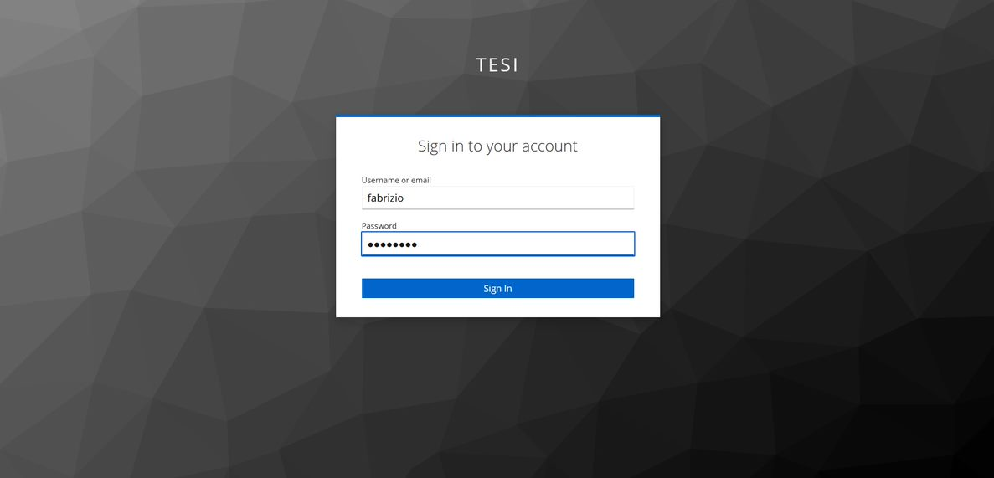
results

Slide 14
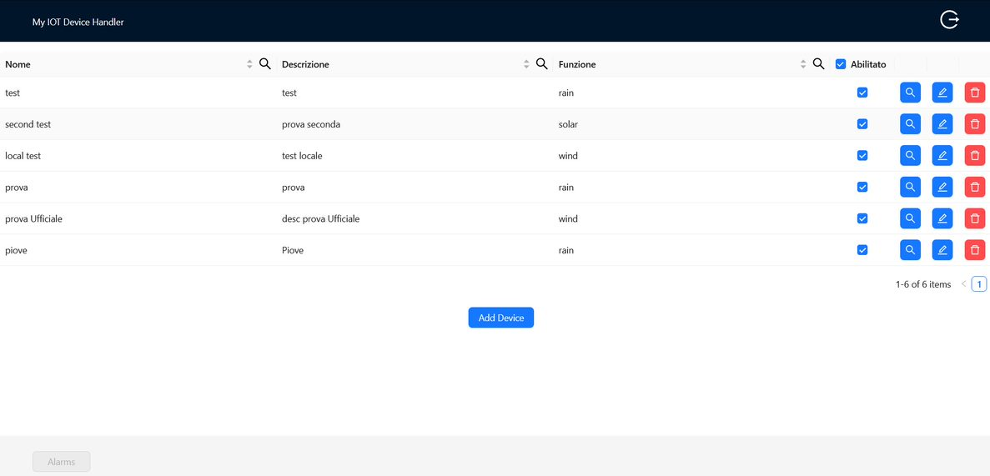
results

Slide 15
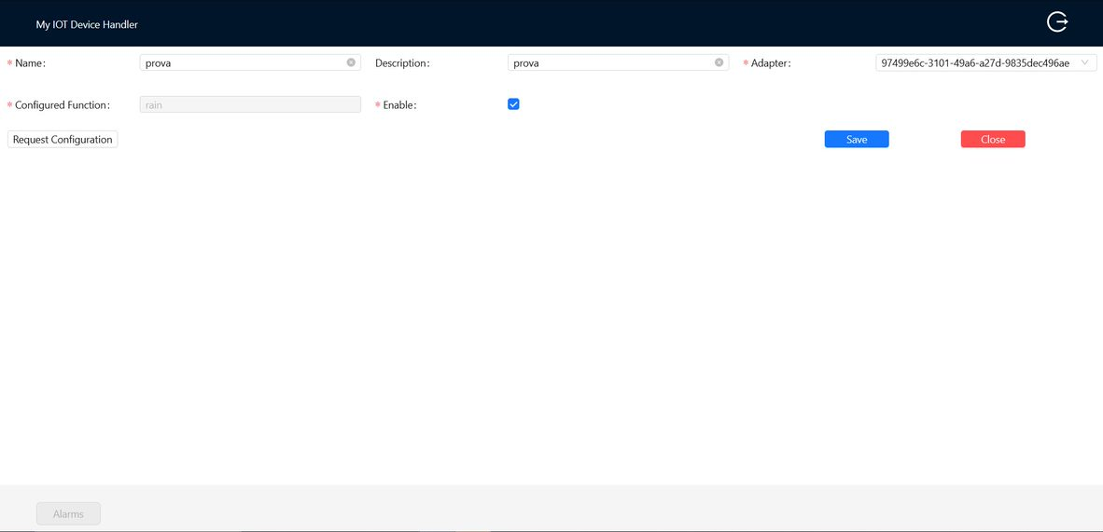
results

Slide 16
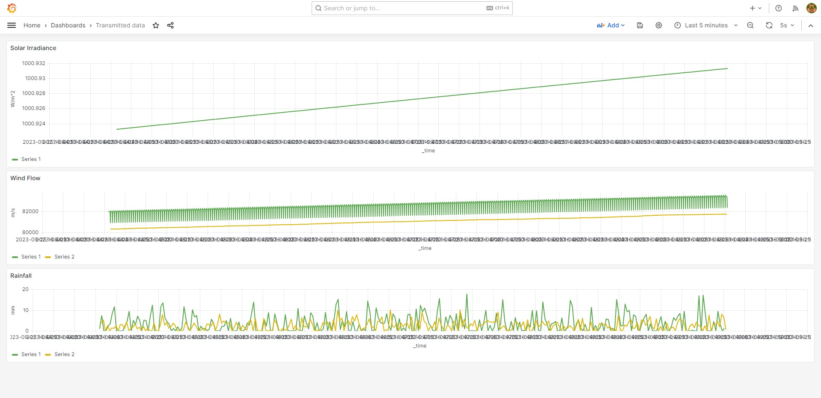
results

Slide 17
CONCLUSION
Achieved goals
Robustness
Scalability
Reliability
User-friendliness

Slide 18
Future developments
REST SERVICE
AdaptersManager
Adapters
Scalability issue Fix:
Change data storing from cache to Influx
Improve Scalability
Reduce RAM consumption
Performance level maintained

Slide 19
Future developments
entities
old entities
CONFIGURATION SCHEDULER
Scalability issue Fix:
Memorization of the previous state of a device from cache to a new MySQL Table
Improve Scalability
Reduce RAM consumption
Performance level improvement

Slide 20
THANK YOU

